Slide 1
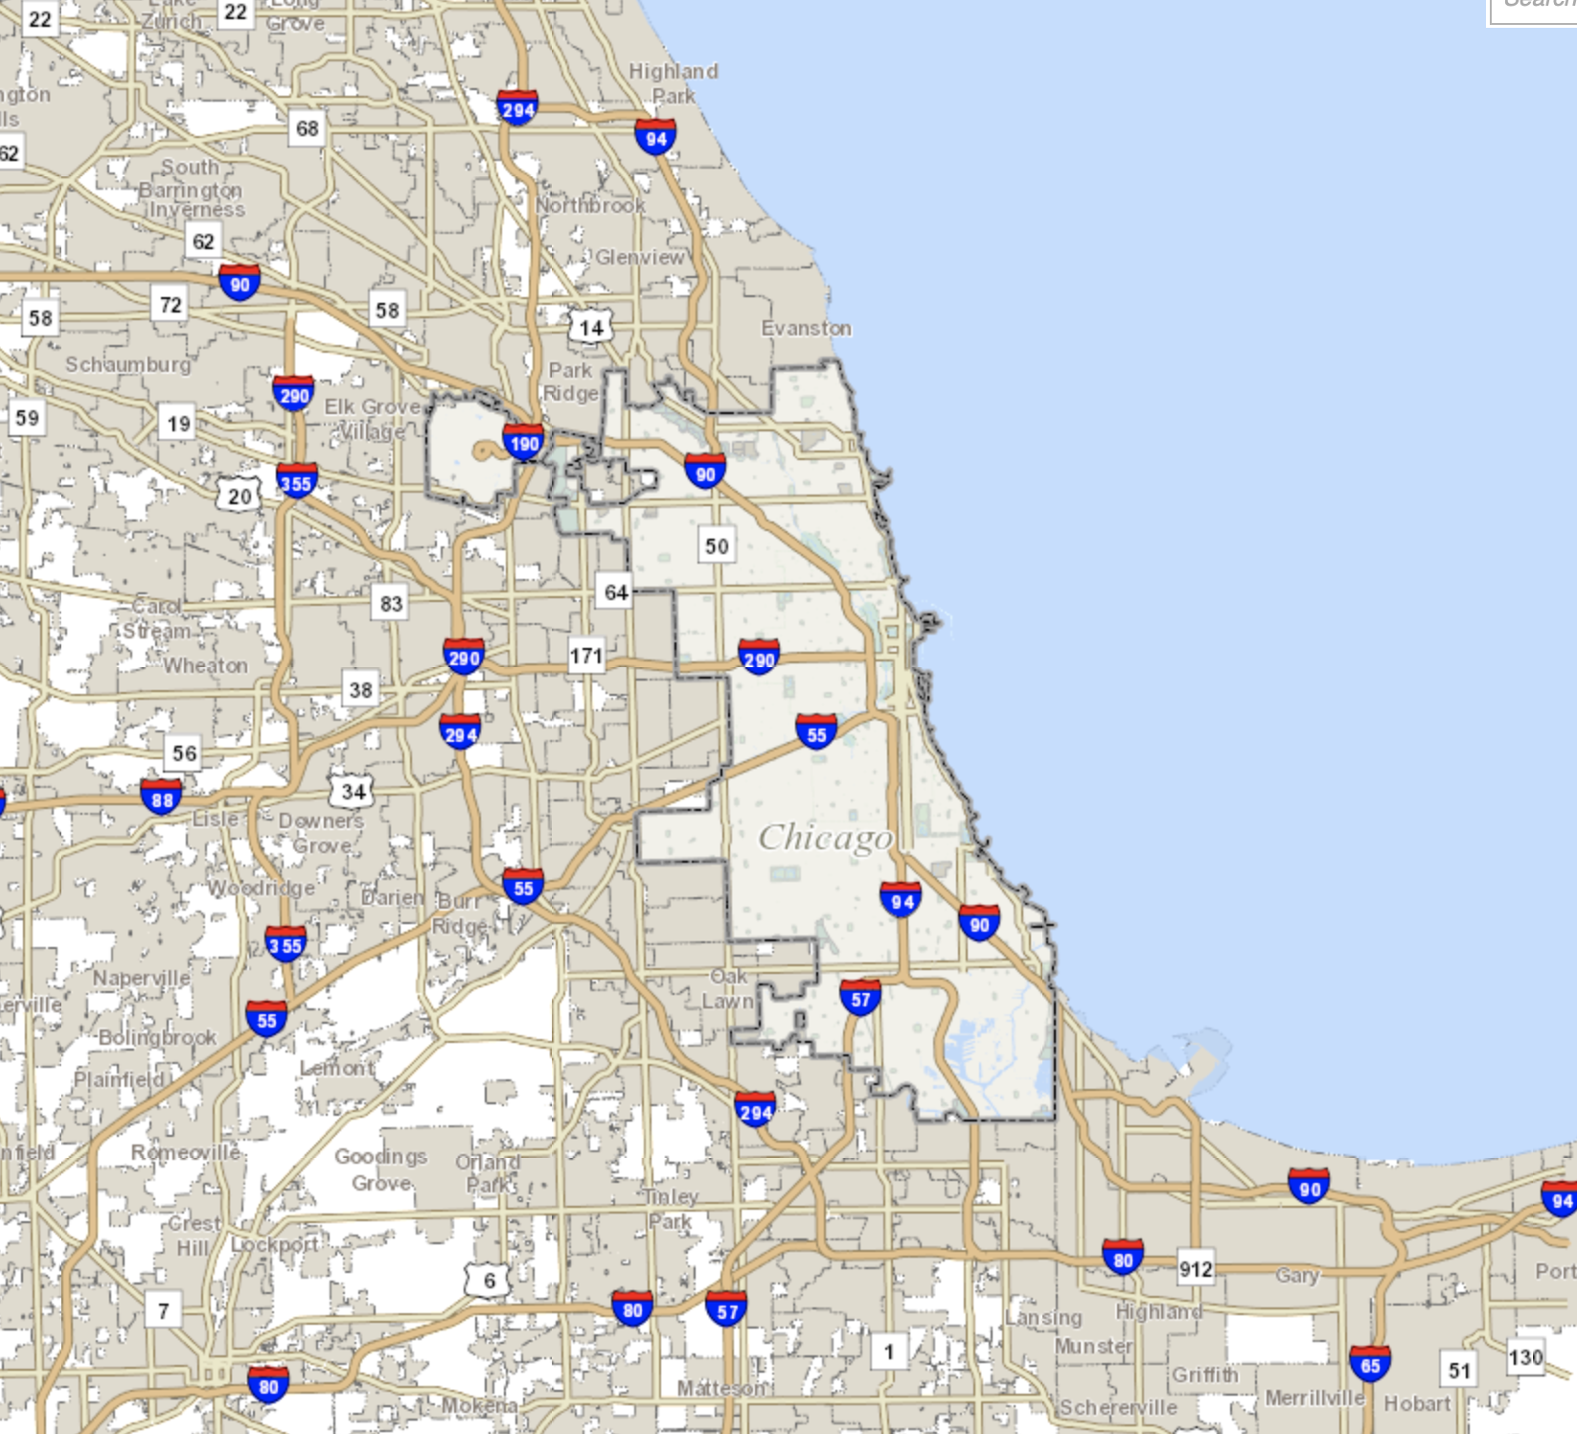
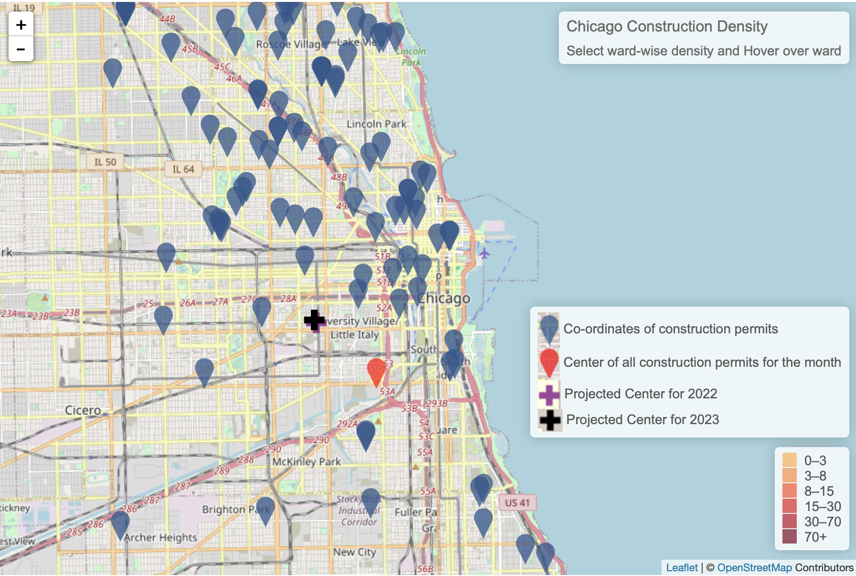
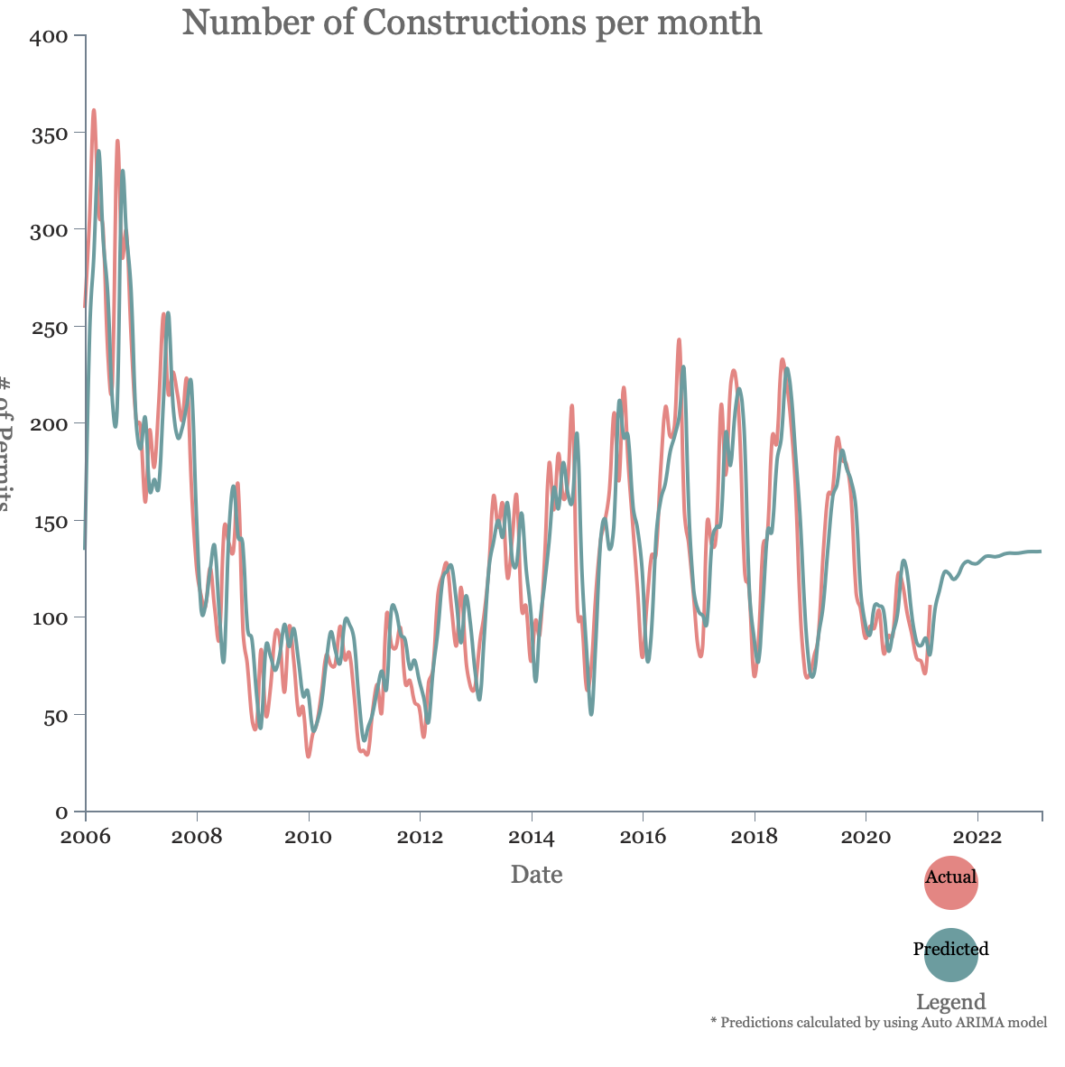
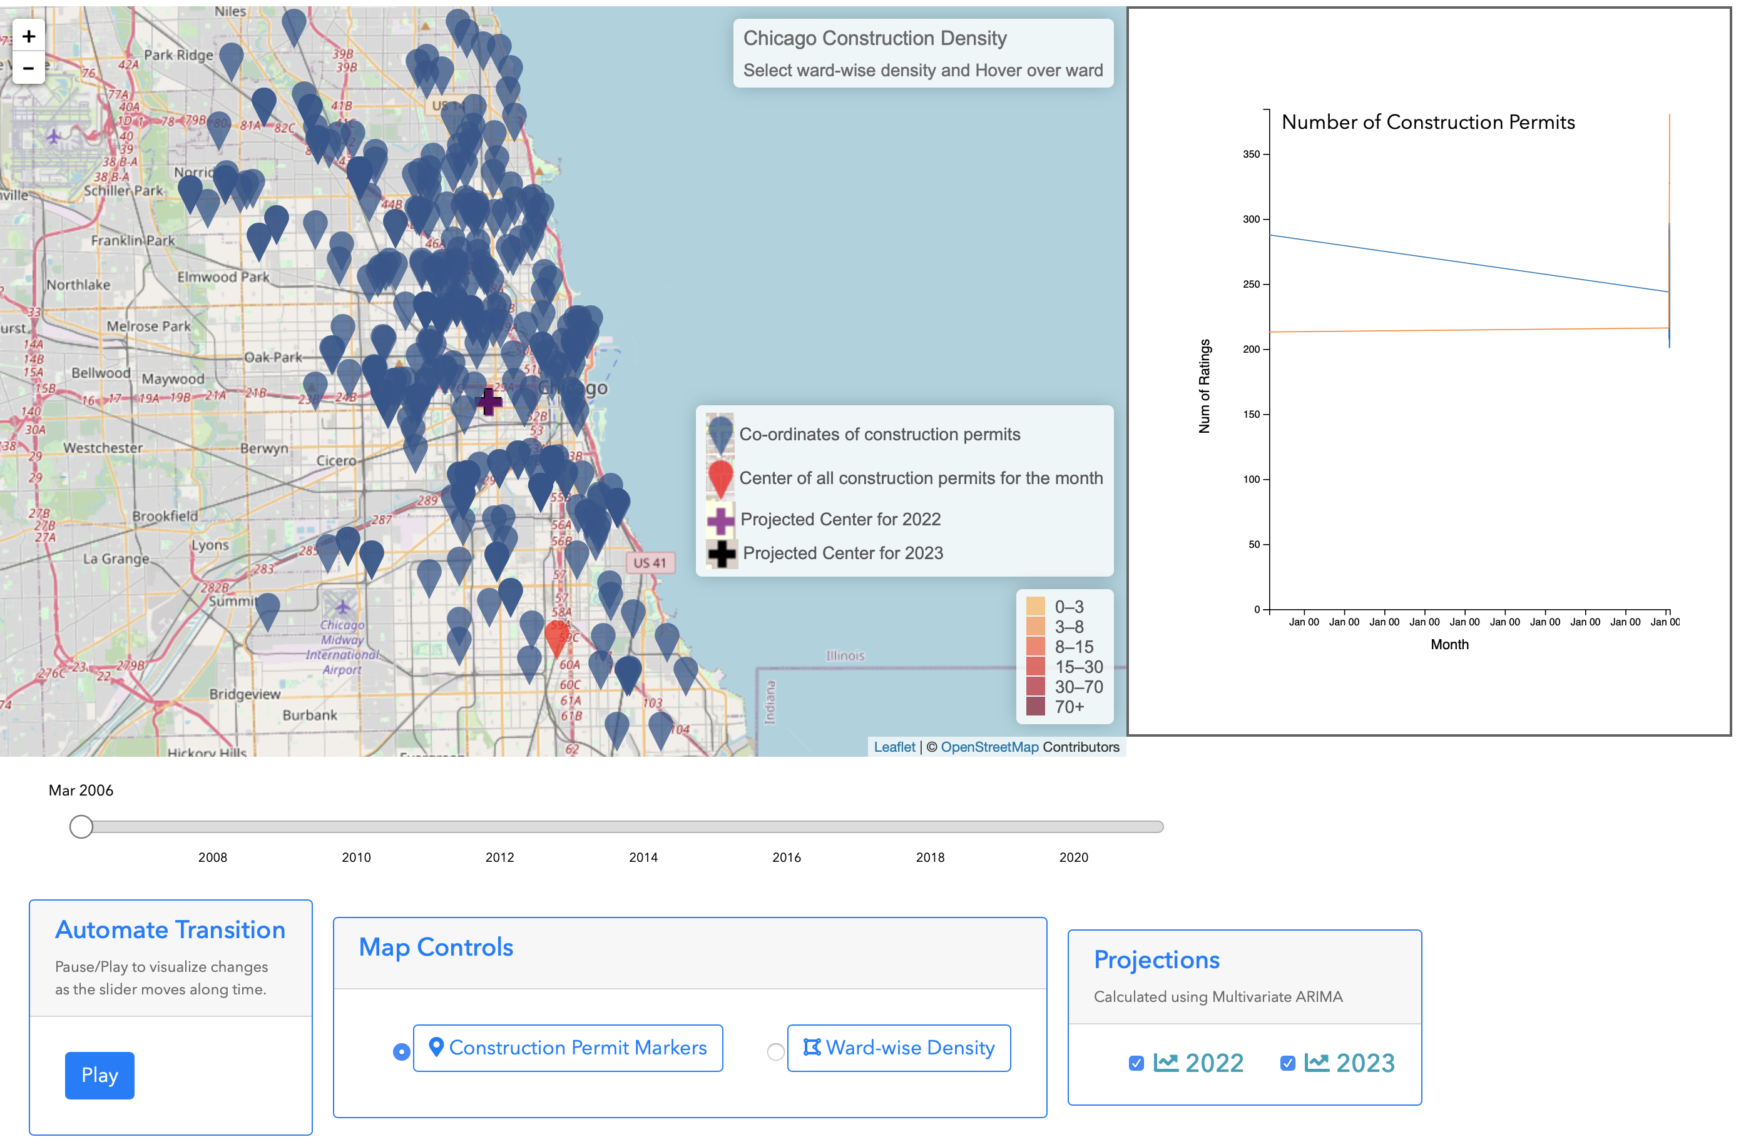
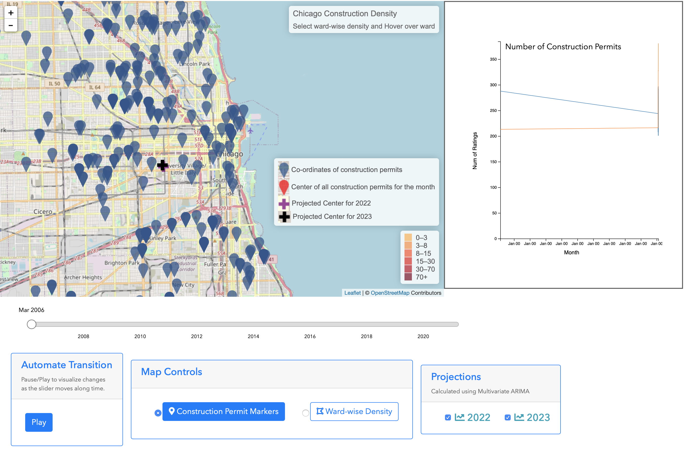
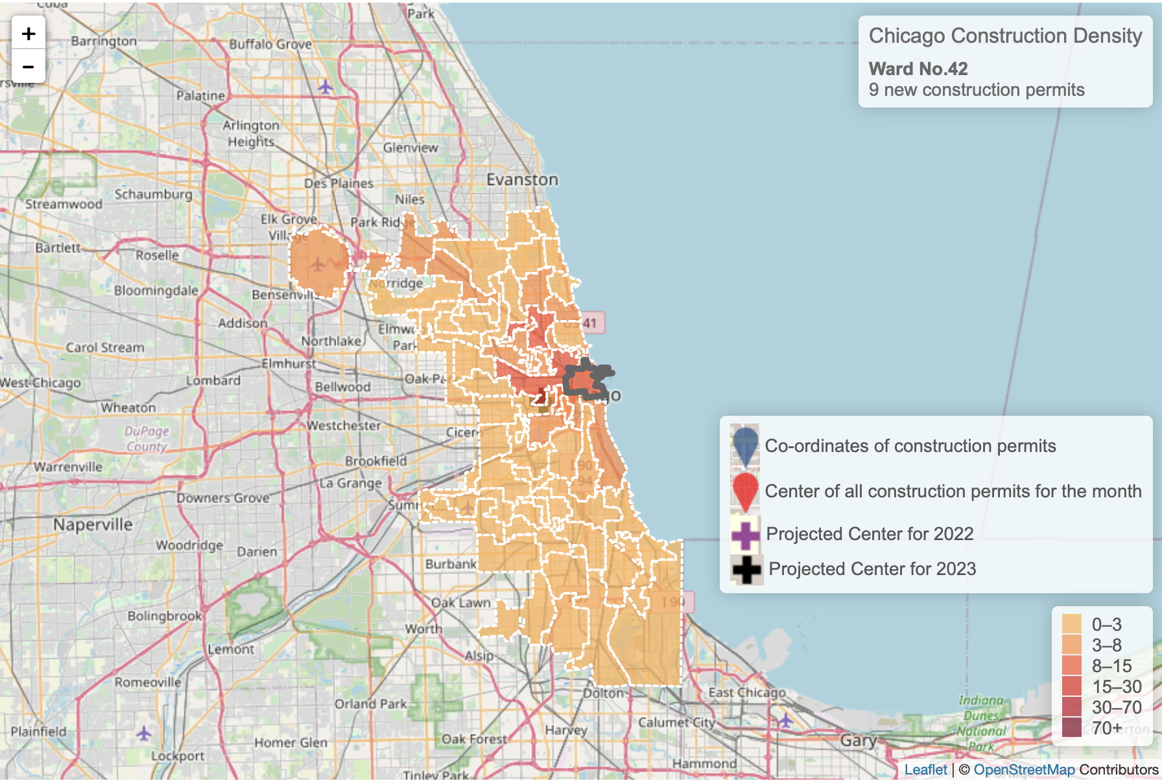
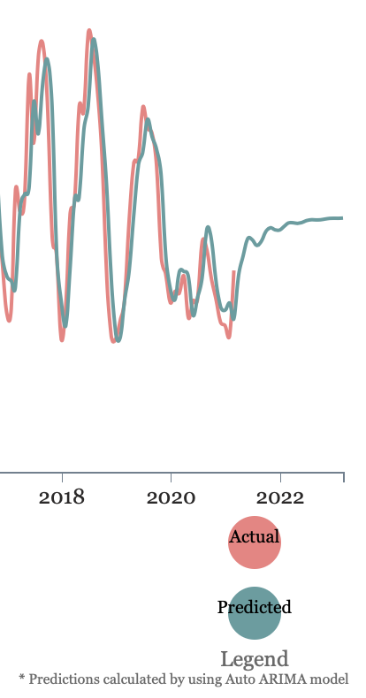
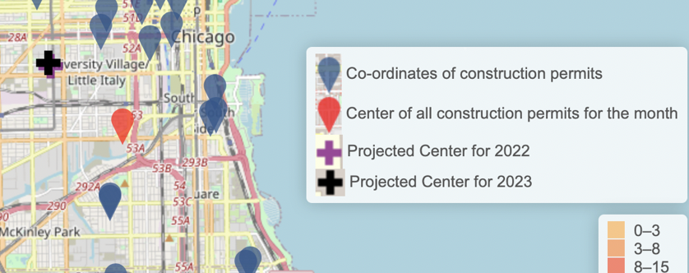
WASP -
Construction Density Analysis for Chicago
Aayush Parwal
Brian Tran
David Scott Bader
Prashant Kubsad
Wael Ahmad Sultan
Motivation & Introduction
WASP is a spatio-temporal visualizer designed to show construction density trends based on analyzing cities’ building permits data, in our case its the city of Chicago. The tool also performs time series analysis to forecast not only the number of monthly permits but also the anticipated hot spots which differentiates it from other websites we observed. It is a beneficial tool for wide range of users including real estate analysts, construction developers and municipalities. Users will be able to draw insights on density movements , and lucrative development areas which could help reduce the decision making time and save the hassle of jumping from one tool to another. In the future, the portal can easily be extended to include other cities and even perform benchmarking analysis.
For visualization we decided to go with
&
Leaflet is the most popular JavaScript library for maps and considered as an easy-to-use and light-weight library. We have enhanced the map by including heatmap view based on polygons representing each ward in Chicago and its respective number of building permits.
In addition, users can switch from heatmap visualization to more detailed view with pins representing permits locations. For the temporal component, we included a slider to navigate between monthly data.
We added a button to animate how construction permits have grown over time including the forecasted period.
On the right side we show the building permits trends and an option to get a couple of years forecast. The whole portal was hosted on AWS servers
Two time series analyses were performed:
1
ARIMA Time series analysis #
Predicting monthly building permits
We performed time series forecasting using the ARIMA model on the monthly grouped data with the desired columns. We used auto ARIMA function to fine tune hyper parameters ( p, d and q ) for the model. The data was split into training and test, and trained the ARIMA model with the best parameters from the previous step based on AIC scores. We then trained the model on all of the data and performed a forecast for new future permits
Play
Vector AutoRegression .
Forecasting construction hotspots
2
Unlike contemporary approaches that rely on factor based modeling such as decision trees trained on median income, proximity to water, and infrastructure investment, we utilized a vector autoregressive model (VAR) constructed with latitude and longitude data of construction permits in order to predict the location of the construction hotspots up to two months in the future. We do this by calculating the mean coordinate data for all construction, grouped by month (beginning in 2011) to obtain the location of the “hotspot” as it moves over time
2 year ARIMA forecast
Data: We used the construction permit data from Chicago city website.
The data set contained information about permits that were not critical to our analysis, like renovation, and electric working.
657,000
Data points
119 fields
We decided to go with only new constructions
The data is fetched in real time with the user monthly period selection embedded in the API get query. This gave us the advantage of working on smaller data size for the visualization and time series analysis
On the experimentation and evaluation front, for both the VAR and ARIMA we used the auto tuning function in the respective library to find the best parameters for our models. Then we relied on MSE and AIC respectively to validate the optimum parameters selection and eventually the prediction performance

